Slide 1
JDK and it’s uses

Slide 2
JDK comes with a collection of tools that are used for developing and running Java program.
It is a bundle of software that you can use to develop Java based applications.
Java Development Kit is needed for developing java applications.

Slide 3
JDK include below :
  Javac: The java Compiler, which translates sourcecode to bytecode files that the interpreter can understand.
  Java: Java interpreter, which runs applications by reading and interpreting bytecode files.
  Appletviewer: it enables us to run java applets without actually using a java compatible browser.
  Javadoc: It creates HTML format documentation from java source code files.
  Jdb: Java debugger, which helps us to find errors.

Slide 4
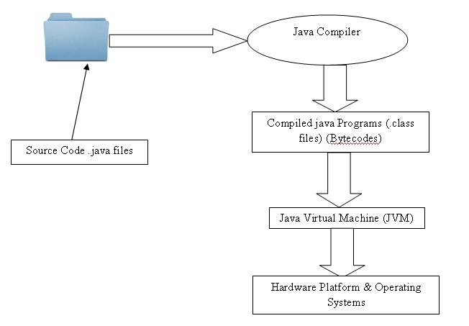
JVM (Java Virtual Machine)

Slide 5
Java Compiler
Java Interpreter
Java debugger
Applet viewer

Slide 6
Program Features
Java is case sensitive language.
All statements must be end with the semicolon.
Java is a built upon C and C++. It derives its syntax from C and the object oriented features are influenced by C++.

Slide 7
General Program Structure:
Document Section
Package Statement
Import Statement
Interface Statement
Class Definitions
Main method class
{
public static void main(String args[])
}

Slide 8
Document Section
Document Section comprise a set of comment lines giving the name of the program, the author and other details, which the programmer would like to refer at a later stage

Slide 9
Package Statement
The first statement allowed in Java is a package statement. Package statement declares a package name and informs the compiler that the classes defined here belongs to this package.
Syntax : package <name>
The package statement is optional, That is, our classes should not have to be part of a package.

Slide 10
Import Statement
This is similar to #include syntax in C
Syntax :
import packagename.classname;
Ex. Import student.test;
    This statement instruct the interpreter to load the test class contained in the package student.

Slide 11
Interface Statement
An interface is like class but includes a group of method declaration.
This is also an optional section and is used only when we wish to implement the multiple inheritance features in the program.

Slide 12
Class Definitions
A Java program may contain multiple class definitions.
Classes are primary and essential elements of Java program.

Slide 13
Main method class
Since every java stand alone program requires a main method as its starting point, this class is an essential part of Java program, All Java applications begin execution by calling main().
A Simple java program may contain only this part.

Slide 14
Main method class
The public keyword is an access specifier, which allows the programmer to control the visibility of class members. When a class member is preceded by public, then that member may be accessed by code outside the class in which it is declared. In this main() must be declared as a public, since it must be called by code outside of its class when the program is started.
The keyword static means the entry point of the program will not change
The keyword void simply tells the compiler that the main() does not return a value.

Slide 15
Main method class con’t
String args[] declares a parameter named args, which is an array of instances of the class String. In this case, args receives any command –line arguments present when the program is executed. If there are no parameters required for a given method, you still need to include the empty parentheses.
System is a predefined class that provides access to the system, and out is the output stream that is connected to the console.
out is actually accomplished by the built-in println() method, pritntln() method displays the String which is passes to it.

Slide 16
Simple Java Program
public class HelloWorld {
//method main(): ALWAYS the APPLICATION entry point
public static void main (String[] args) { System.out.println ("Hello World !");
}
}

Slide 17
For compiling this program
  javac HelloWorld.java
For running this program
  java HelloWorld

Slide 18
JRE (Java Runtime Environment)
Since it is a newer language, it is not natively supported by all operating systems.
Therefore, a Java Runtime Environment may need to be installed on your computer.
Developed by SUN MICROSYSTEM and includes the Java Virtual Machine.
If the JRE is not installed on a computer, Java programs may not be recognized by the Operating System and will not run.
The JRE software provides a runtime environment in which Java programs can be executed.

